Slide 1
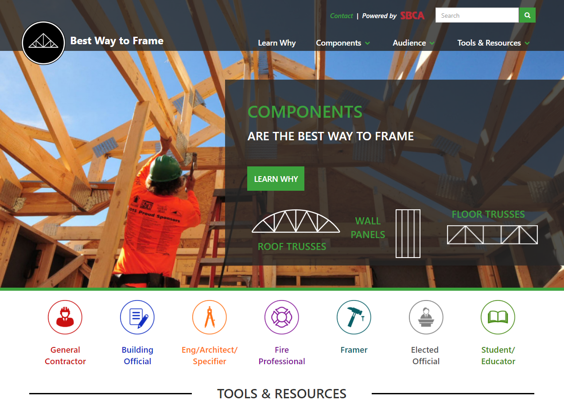
Best Way to Frame
Resources on components for a variety of audiences.
www.bestwaytoframe.com/*company*
Technical Resources
Best Practices
Industry Information

