Slide 1
Fire Retardants and Truss Design
Overview

Slide 2
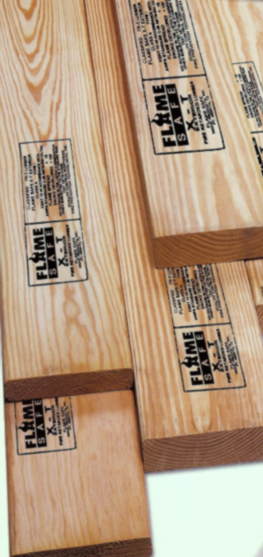
Introduction
Fire retardant treatments (FRT) were developed to be applied to building materials, such as dimension lumber (FRTW) and plywood, to reduce the ability of the wood to fuel a fire.
This treatment can allow FRT materials to be used as an acceptable alternative for building code requirements that specify noncombustible material in specific applications.

Slide 3
Introduction
This treatment does not make wood a noncombustible material as defined by the building codes but it does reduce the ability of the treated wood to contribute significantly to the growth of a fire.
The treatments must be carefully applied according to applicable standards.

Slide 4
Introduction
While reducing the flammability of the wood, the fire retardant treatments may also cause degradation of the structural properties of the wood.
Depending on the treatment, constructing buildings with FRTW may require:
A reduction in the design values of the wood materials, and/or
A reduction in the capacity of connectors used

Slide 5
Introduction
There are FRT treatments for both interior and exterior use.
The focus of this presentation is on interior use of FRTW, specifically when and how FRTW is permitted to be used in Truss design.

Slide 6
Introduction
The wood or product is impregnated with a mineral salt or water insoluble organic retardant, generally a resin polymer or graft polymer that reduces the temperature of thermal degradation, which results in more charring and a decrease of flammable volatiles.

Slide 7
Introduction
The Structural Building Components Association (SBCA) has developed this presentation to provide a clear perspective on the use of fire retardant materials used in construction.
The analysis is based on code requirements developed by the International Code Council within the 2012 and 2015 International Building Code (IBC), ANSI/TPI I as well as other industry resources.

Slide 8
Key Definitions
Building - Any structure used or intended for supporting or sheltering any use or occupancy.
Building Code - As it applies to a Building, any set of standards set forth and enforced by a Jurisdiction for the protection of public safety.
Combustible Material - A material that does not qualify as noncombustible.
Noncombustible Material - A material that, under the conditions anticipated, will not ignite or burn when subjected to fire or heat. Materials that pass ASTM E136 are considered noncombustible materials.

Slide 9
Key Definitions
Fire Retardant-treated Wood (FRTW) - Wood products that, when impregnated with chemicals by a pressure process or other means during manufacture, exhibit reduced surface-burning characteristics and resist propagation of fire.
Truss - Individual metal-plate-connected wood component manufactured for the construction of a Building.
Truss Designer - Person responsible for the preparation of the Truss Design Drawings.

Slide 10
Key Definitions
Truss Manufacturer - Person or organization engaged in the fabrication of Trusses.
Truss Design Drawings (TDD) - The written, graphic and pictorial depiction of each individual truss shall be provided to the building official for approval prior to installation. Truss design drawings shall also be provided with the shipment of trusses delivered to the job site. Truss design drawings shall include, at a minimum, the information specified below: [2303.4.1.1]

Slide 11
Background
Code requirements related to fire-retardant-treated wood are located in two places in the IBC.
Chapter 6 of the IBC details under what circumstances fire retardant treated wood is permitted, and the acceptable exceptions to these rules.
Chapter 23 governs the materials, design, construction and quality of wood members and their fasteners, including FRTW.

Slide 12
Background
Requirements related to fire retardant materials specific to trusses are located in ANSI/TPI 1 – Design Standard for the Manufacture of Metal Plate Connected Wood Trusses.
Chapter 3 of ANSI/TPI 1 stipulates that lumber treated with fire retardant chemicals must be identified and clearly marked by the manufacturer.
Chapter 6 of ANSI/TPI 1 details the appropriate reductions for both lumber design values and metal connector plate values, including FRTW.

Slide 13
Background
AWC NDS includes fire-retardant-treatment reductions for the material in Chapter 2 and connections in Chapter 11:
2.3.4 Fire Retardant Treatment The effects of fire retardant chemical treatment on strength shall be accounted for in the design. Adjusted design values, including adjusted connection design values, for lumber and structural glued laminated timber pressure-treated with fire retardant chemicals shall be obtained from the company providing the treatment and redrying service. Load duration factors greater than 1.6 shall not apply to structural members pressure-treated with fire retardant chemicals (see Table 2.3.2).
11.3.5 Fire Retardant Treatment Adjusted design values for connections in lumber and structural glued laminated timber pressure-treated with fire retardant chemicals shall be obtained from the company providing the treatment and redrying service (see 2.3.4). The impact load duration factor shall not apply to connections in wood pressure-treated with fire retardant chemicals (see Table 2.3.2).

Slide 14
Background
IBC Chapter 6 addresses types of construction and includes information on when and where fire-retardant-treated wood may be used.
Fire retardant materials are permitted in non-bearing walls with low fire-resistance ratings and in roof construction and decking.
IBC Chapter 23 Wood includes information regarding fire-retardant-treated wood.
IBC Chapter 6 (2015)
IBC Chapter 23 (2015)

Slide 15
Background
ANSI/TPI Chapter 3 – Quality Criteria for the Manufacture of Metal-Plate-Connected Wood Trusses includes the requirement that fire retardant treated lumber must be clearly identified and marked.
3.4.4 Preservative Treatment Identification.
3.4.5 Fire Retardant Identification
§3.4.4 Preservative Treatment & §3.4.5 Fire Retardant Identification.
§ = commentary

Slide 16
Background
ANSI/TPI Chapter 6 – Materials and General Design Considerations covers acceptable conditions for the FRTW before installation as well as possible design value reductions.
Reductions may depend on ambient conditions at the building site.
Design values must be approved by local authorities.
Truss engineering software can apply FRTW plate and lumber reductions
6.4.9.1 Fire Retardant Treated (FRT) Lumber.
6.4.9.2 Metal Connector Plates Installed in FRT
§6.4.9 Chemically Treated Lumber.
§6.4.9.2 Metal Connector Plates Installed in FRTW.
§ = commentary

Slide 17
Analysis

Slide 18
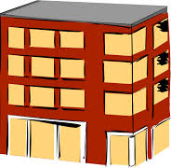
Analysis – Allowable Uses
Type I: Fire-Resistive
High and mid rise buildings
Exterior and interior must be non-combustible
Type II: Non-Combustible
New commercial buildings and remodels
Exterior and interior must be non-combustible
602.2 Types I and II
I
II

Slide 19
Analysis – Allowable Uses
In Types I and II FRTW may be used:
In nonbearing partitions rated 2 hours or less.
In nonbearing exterior walls where fire rating is not required.
In roof construction, including girders, trusses, framing and decking.
Exception: In type IA over 2 stories, FRTW is not permitted in roofs when the vertical distance from the upper floor to the roof is <20 feet
603.1 Allowable materials.
I
II

Slide 20
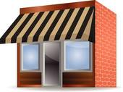
Analysis – Allowable Uses
Type III: Ordinary (Combustible)
Exterior must be noncombustible
Interior may be any permitted by code
III

Slide 21
Analysis – Allowable Uses
In Type III, FRTW may be used:
In place of non-combustible materials within exterior wall assemblies of a 2-hour rating or less.
In other building elements, FRTW is permitted (though not required) if the construction meets the specific fire-resistance rating given in Table 601.
602.3 Type III
Table 601
III

Slide 22
Analysis – Allowable Uses
Type IV (Heavy Timber)
Exterior must be noncombustible
Interior must be solid or laminated wood without concealed spaces
602.4 Type IV
IV

Slide 23
Analysis – Allowable Uses
In Type IV (Heavy Timber), FRTW may be used:
In place of non-combustible materials within exterior wall assemblies of a 2-hour rating or less.
602.4.1 Fire-retardant-treated wood in exterior walls.
IV

Slide 24
Analysis – Allowable Uses
Type V construction
Exterior and interior walls may be any permitted by code
602.5 Type V
V

Slide 25
Analysis – Allowable Uses
In Type V, FRTW may be used:
In all building elements, FRTW is permitted (though not required)
Note: in Type V-A major building elements must be protected by a 1-hour fire resistant rating.
V

Slide 26
Analysis – Allowable Uses
FRTW use is also permitted in accordance with the footnotes to Table 601 as applicable to Roof Construction in Type IA, 1B, IIA, IIIA and VA as follows (emphasis added):
b. Except in Group F-1, H, M and S-1 occupancies, fire protection of structural members shall not be required, including protection of roof framing and decking where every part of the roof construction is 20 feet or more above any floor immediately below. Fire-retardant-treated wood members shall be allowed to be used for such unprotected members.

Slide 27
Analysis – Allowable Uses
FRTW is advantageous in some cases related to sprinklering.
Per Section 8.15.1.2.11 of NFPA 13 Standard:
Concealed spaces in which the exposed materials are constructed entirely of fire-retardant treated wood as defined by NFPA 703 … shall not require sprinkler protection.
This means that if FRTW is used in concealed spaces, sprinklers are not required, saving time and money.

Slide 28
Analysis – Material Requirements
Since FRTW is allowed in some applications where noncombustible materials are otherwise required, it is important that these products meet rigorous requirements.
IBC Section 2303.2 requires the material to be tested in accordance with ASTM E84, with the test duration increased by 20 minutes.

Slide 29
Analysis – Material Requirements
Using this procedure, a flame spread index is established during the standard test period.
The test is continued for an additional 20 minutes.
During this added time period, there must not be any significant flame spread and at no time can the flame spread more than 10¹/₂ feet (3200 mm) past the centerline of the burners.

Slide 30
Analysis – Material Requirements
What is meant by impregnation? (IBC 2303.2)
Impregnation does not mean the chemical penetrates all the way through the lumber.
The penetration depth may vary with lumber species and treatment method.
There is no definition of how much penetration is needed to be called “impregnated”.

Slide 31
Analysis – Material Requirements
Section 2303.2.2 requires that FRTW must be a permanent protection of all surfaces.
Treatments that stay on the lumber surface and can be chipped off or lose their bond to the lumber are not FRTW.
Those products would need to be qualified as an alternative material under IBC Section 104.11 or IRC section R104.11.

Slide 32
Analysis – Material Requirements
Treatment by other than a pressure process is addressed in Section 2303.2.3.
Here equivalent performance is required from all sides of the FRTW product, so that orientation of the product is not an issue.
The intent is that all sides of the material is protected.
The requirement in this code section is that the product must be tested on all sides.

Slide 33
Analysis – Material Requirements
This is problematic from a testing perspective.
How does one determine what is the front or back side of a piece of lumber?
If I test one side of a sample, I cannot use that same sample for the next test. A new sample must be used.
How do I then determine which side to test? What is the front side? What is the back side?
Meeting this requirement is not typically possible so some judgement on the part of the testing facility is necessary.

Slide 34
Analysis – Material Requirements
Specifics related to design value adjustments are discussed below, but IBC Section 2303.2.6 also requires consideration of situations when FRTW may be exposed to the weather or may be used in damp or wet locations.
This requires evaluation of the flame spread index when tested in accordance with ASTM D2898, Standard Practice for Accelerated Weathering of Fire-Retardant-Treated Wood for Fire Testing.

Slide 35
Analysis – Material Requirements
This test is applicable only to pressure treated material and simulates effects of leaching, drying, temperature and, in one method, ultraviolet light.
If the FRTW product might be subject to these environmental concerns, the FRTW manufacturer must state that testing to ASTM D2898 has been completed for their product.
IBC Section 2303.2.8 requires that FRTW drying temperatures are not to exceed those typically used for non-FRTW.

Slide 36
Analysis – Design Requirements
IBC Section 2303.2.5 & 2303.2.5.2 state that FRTW must be tested to determine applicable adjustment factors in accordance with ASTM D5664, taking into account both the impact of the chemical treatment and the environment in which the FRTW product is to be used.

Slide 37
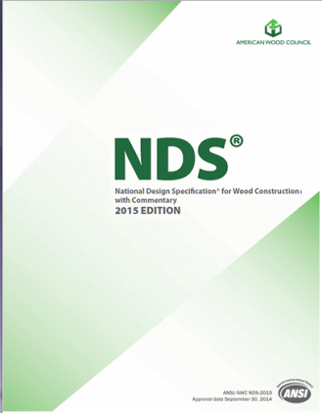
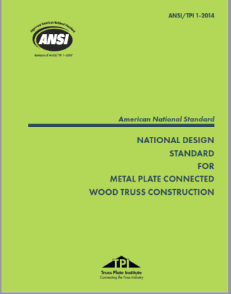
Analysis – Design Requirements
NDS and TPI 1 are all clear that applicable adjustments to design values are to be provide by the FRTW material supplier.
All of the FRTW material suppliers do provide reductions for design values based on their chemical and process applicable to specific wood species.

Slide 38
Analysis – Design Requirements
The adjustment values should be based on current product information and typically include reductions to the following material properties:
Compression Parallel to Grain
Horizontal Shear
Tension Parallel to Grain
Bending – Modulus of Elasticity
Bending – Extreme Fiber Stress
Fasteners/Connectors

Slide 39
Analysis – Design Requirements
There may also be additional design value adjustment factors for FRTW used in high temperature applications.
However, since most FRTW material suppliers do not stock the higher grades of lumber typically used in trusses, the truss manufacturer may have to take into account sending material out to be treated.

Slide 40
Conclusion
Fire retardant treated materials can be incorporated into Buildings to reduce the ability of lumber products to contribute to a fire.
The IBC requirements dictate where, and under what circumstances, fire retardant materials are allowed.
When designing trusses with fire retardant lumber, ANSI/TPI 1 should be followed as a guide for the appropriate drying conditions for the lumber after treatment.
In addition, appropriate design values reductions for the lumber or metal connector plate should be taken following the FRT manufacturer’s specifications.

Slide 41
References
ANSI/AWC National Design Specification® (NDS®) for Wood Construction
ANSI/TPI-1 National Design Standard for Metal Plate Connected Wood Truss Construction
International Building Code (IBC), International Code Council
International Residential Code (IRC), International Code Council
NFPA 13 Standard for the Installation of Sprinkler Systems
United States Department of Agriculture, Forest Products Laboratory (U.S.), Wood Handbook, Wood as an Engineering Material, Chapter 18, 2010,

Slide 42
References
ASTM D2898 - Standard Practice for Accelerated Weathering of Fire-Retardant-Treated Wood for Fire Testing
ASTM D3201 - Standard Test Method for Hygroscopic Properties of Fire-Retardant Wood and Wood-Based Products
ASTM D5516 - Standard Test Method for Evaluating the Flexural Properties of Fire-Retardant Treated Softwood Plywood Exposed to Elevated Temperatures
ASTM D5664 - Standard Test Method for Evaluating Dowel-Bearing Strength of Wood and Wood-Based Products
ASTM D6841 - Standard Practice for Calculating Design Value Treatment Adjustment Factors for Fire-Retardant-Treated Lumber
ASTM E84 - Standard Test Method for Surface Burning Characteristics of Building Materials
ASTM E136 - Standard Test Method for Behavior of Materials in a Vertical Tube Furnace at 750°C

Slide 43
Truss Design With Fire Retardant Materials
1) Select appropriate building material in accordance with the provisions of the IRC and/or local building code which corresponds to the structure to be built.

Slide 44
Truss Design With Fire Retardant Materials
2) Find the fire retardant material’s engineering report as provided by the manufacturer in order to ascertain proper lumber and fastener design values.
- Note: Some engineering reports will report these values as reductions from published design values as shown in ANSI/TPI 1 and NDS.

Slide 45
Truss Design With Fire Retardant Materials
3) Verify building material requirements as given by manufacturer for special installation or fastener requirements. -Note: Some fire retardant lumber products require the use of specialized connector plates and fasteners.

Slide 46
Truss Design With Fire Retardant Materials
4) Carefully input design values and plate reductions as provided by the manufacturer into the design software’s database.

Slide 47
Truss Design With Fire Retardant Materials
5) Provide any additional required notes as to special installation or fastener requirements for the fire resistant truss assembly on the truss design drawing.

Slide 48
Truss Design With Fire Retardant Materials
6) Provide information regarding the safe handling or health considerations (i.e. MSDS) as provided by material manufacturer to truss manufacturer and truss installation personnel.

