Slide 1
Truss Repair and Modifications
Overview
Revised 4/7/2017

Slide 2
SBCA has been the voice of the structural building components industry since 1983, providing educational programs and technical information, disseminating industry news, and facilitating networking opportunities for manufacturers of roof trusses, wall panels and floor trusses. SBCA endeavors to expand component manufacturers’ market share and enhance the professionalism of the component manufacturing industry.
Copyright © 2017 Structural Building Components Association.

Slide 3
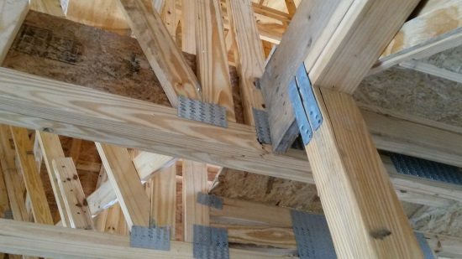
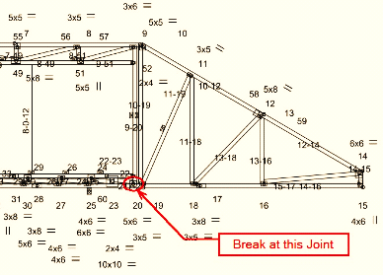
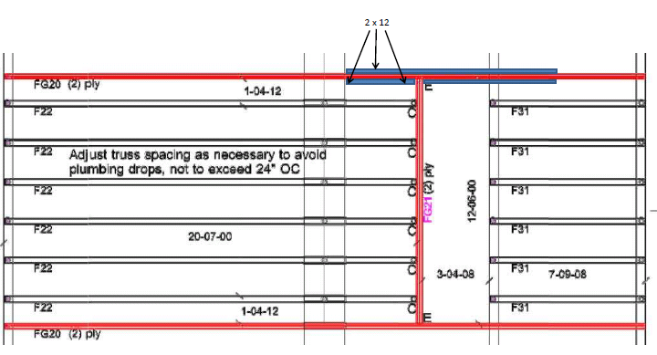
Introduction
Trusses are typically designed for a specific application.
Therefore, truss repairs or modifications must be analyzed on a case by case basis.
The repair designer needs to be provided with accurate information.
  In simple scenarios, a “marked-up” Truss Design Drawing (TDD) or photos of the damaged truss may be sufficient.
  In more complex situations, a jobsite visit may be required.

Slide 4


Introduction
What is the difference between a Repair and a Modification?
  Truss Repair (top): restoring a truss back to its original shape and strength in situations where damage has caused a change or a reduction in either.
  Truss Modification (bottom): altering a truss profile, loading, and/or bearing conditions to fit a situation for which the original truss was not designed.

Slide 5
Introduction
The truss repair or modification must result in a truss that is able to safely carry all intended loads.
Depending on the extent of damage, some trusses cannot be repaired and must be replaced.
This presentation will cover the fundamental principles behind truss repair, as well as steps for a successful truss repair.

Slide 6
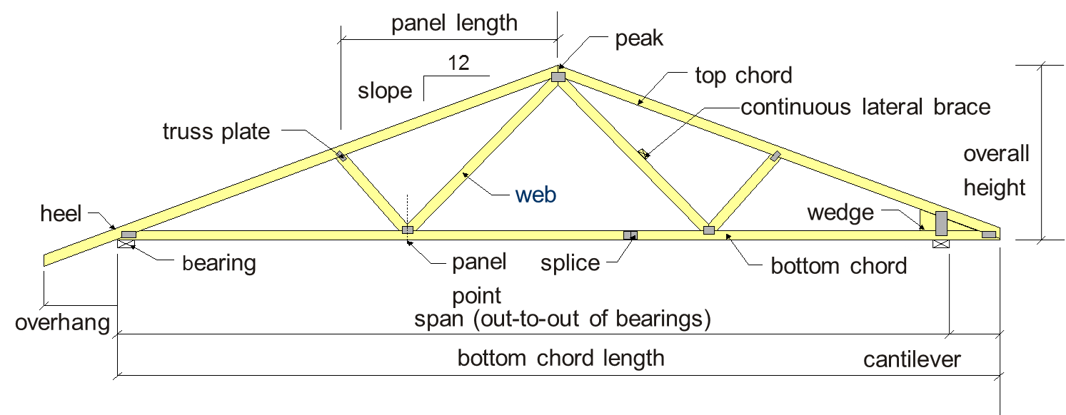
Key Definitions

Slide 7
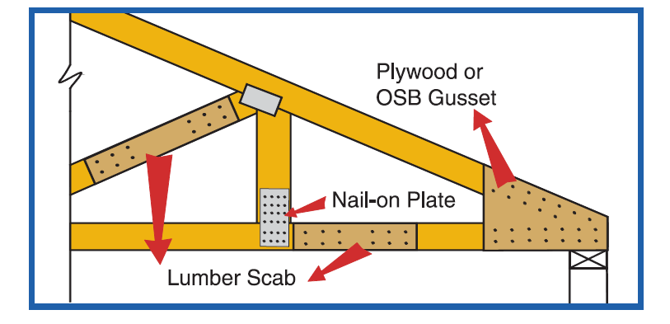
Key Definitions
Further definitions specific to truss repairs

Slide 8
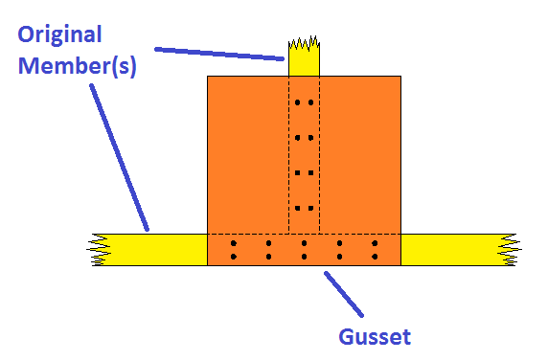
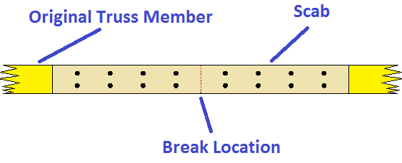
Key Definitions
Gusset repair (OSB/Plywood)
Scab repair (lumber/engineered wood)

Slide 9
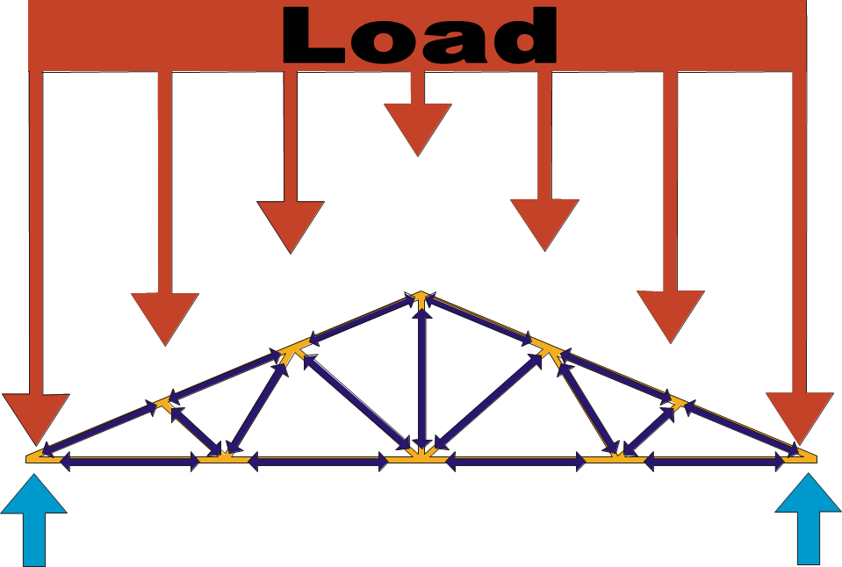
Design Concepts
Load vs. Resistance
Externally applied loads become internal forces

Slide 10
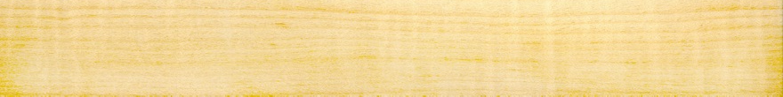
Design Concepts
Axial Forces:
  Axial forces act parallel to the member
  There are two types of axial forces:
    Tension forces pull on each truss member
    Compression forces push on each truss member
  These forces are developed through the resistance of the truss members to gravity, wind, and other design loads.
Tension
Compression

Slide 11
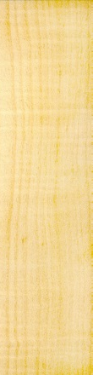


Design Concepts
Shear Forces:
  Act perpendicular to a member’s longitudinal direction.
  Shear force is highest at joints, concentrated load locations, and bearing locations.
Shear

Slide 12
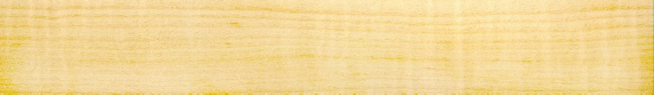
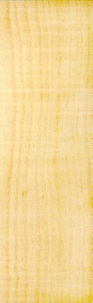

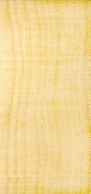
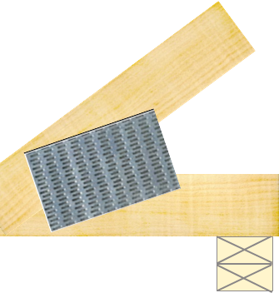
Design Concepts
Moment Forces:
  Cause rotation
  Depending on the fixities of the joints, can occur in chords and sometimes in the webs.
  Are highest in heels, peak, pitch-breaks, and chord joints where large axial forces come together either at different angles and/or in opposing directions (tension versus compression).
  In some cases, the moment acting on the joint will be greater than any of the axial forces
  This will not necessarily show up on the design drawing, but will be accounted for in the design of the gusset plate.
Moment

Slide 13
Reasons for Repairs
Damage occurring during the construction process:
  Manufacturing errors
  Storage, handling, and installation errors
  Jobsite modifications
  Overloading
Design, construction, and serviceability problems

Slide 14
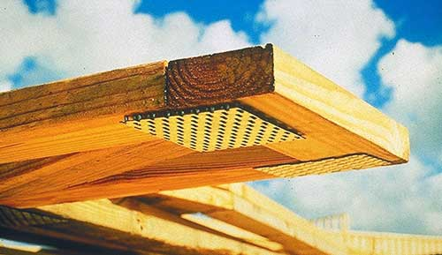
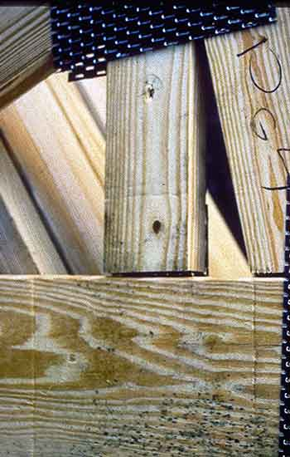
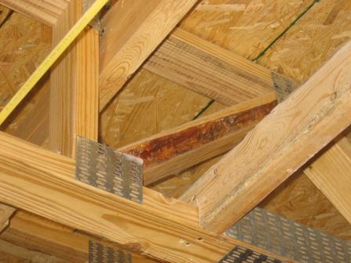
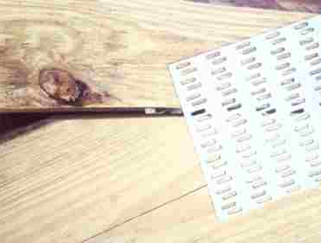
Reasons for Repairs – Manufacturing Errors
Incorrect, loose, missing, or mis-installed connector plates
Poorly constructed joints
Incorrect lumber

Slide 15
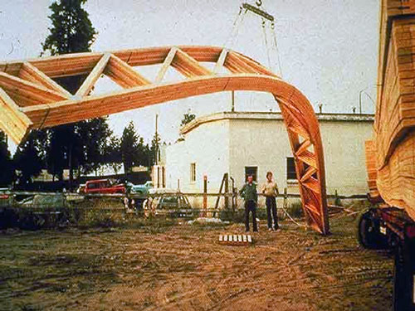
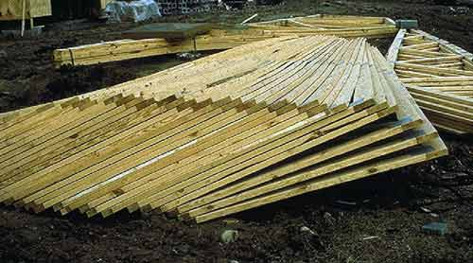
Reasons for Repairs – Storage, Handling, and Installation
Rigging and hoisting mistakes
Lack of protection from the elements

Slide 16
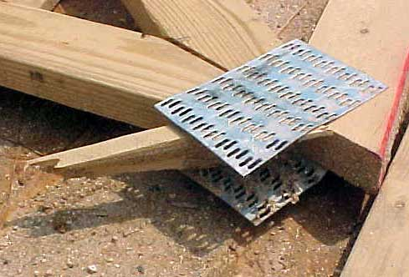
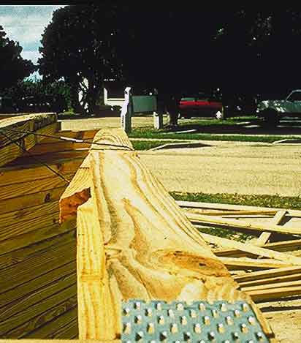
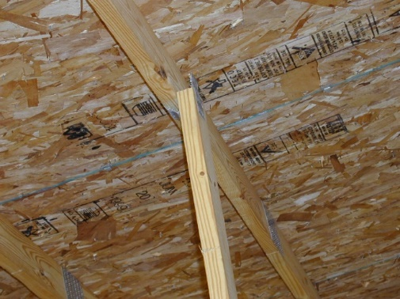
Reasons for Repairs – Storage, Handling, and Installation
Plate and lumber damage can result from improper handling

Slide 17
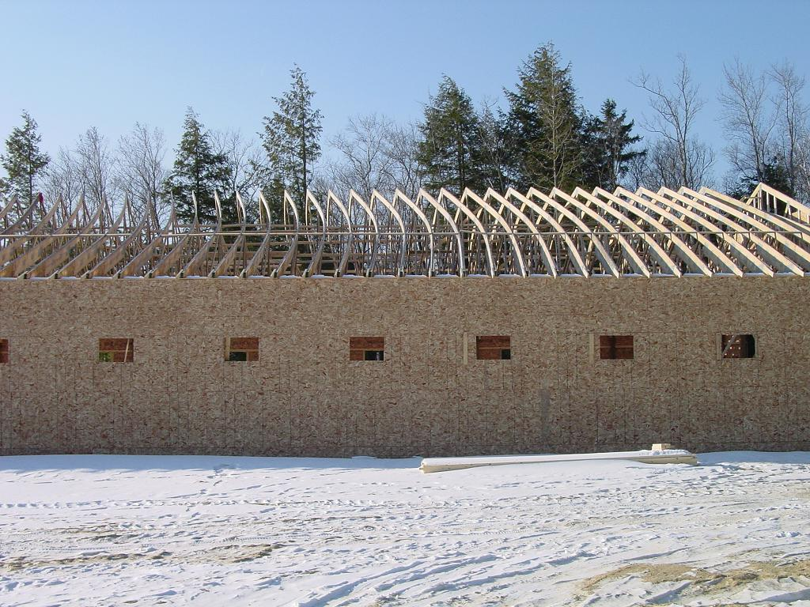
Reasons for Repairs – Storage, Handling, and Installation
Insufficient restraint and bracing

Slide 18
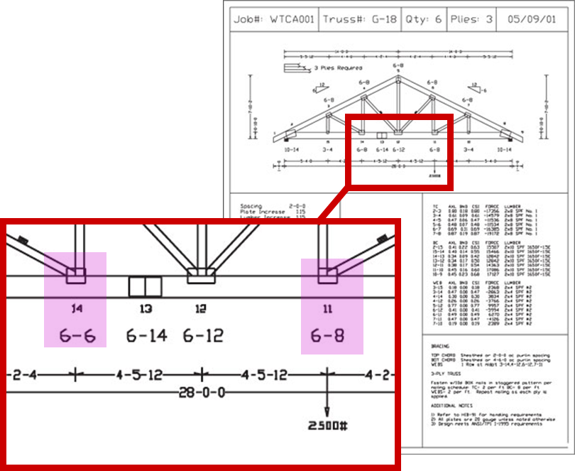
Reasons for Repairs – Storage, Handling, and Installation
Check truss orientations before installing
This is especially important for unevenly
loaded girders

Slide 19
Reasons for Repairs – Storage, Handling, and Installation
Be sure to check both left-to-right and upside down orientations

Slide 20
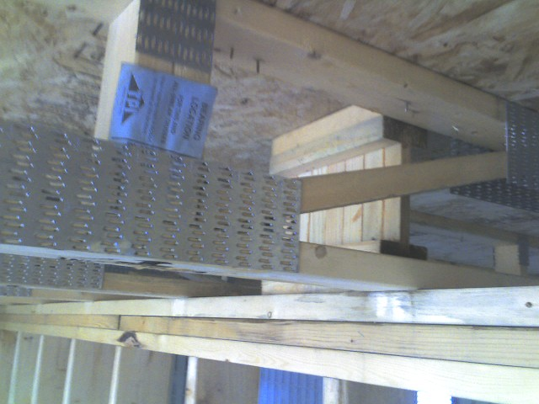
Reasons for Repairs – Storage, Handling, and Installation
Check bearing locations
Are supports in the correct locations?

Slide 21
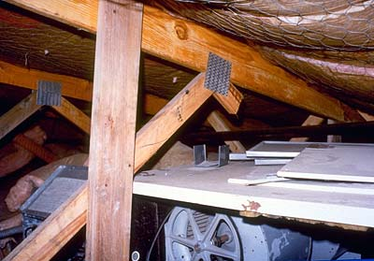
Reasons for Repairs – Jobsite Modifications
Cutting webs or chords to accommodate mechanical equipment (or for any reason) requires a repair

Slide 22
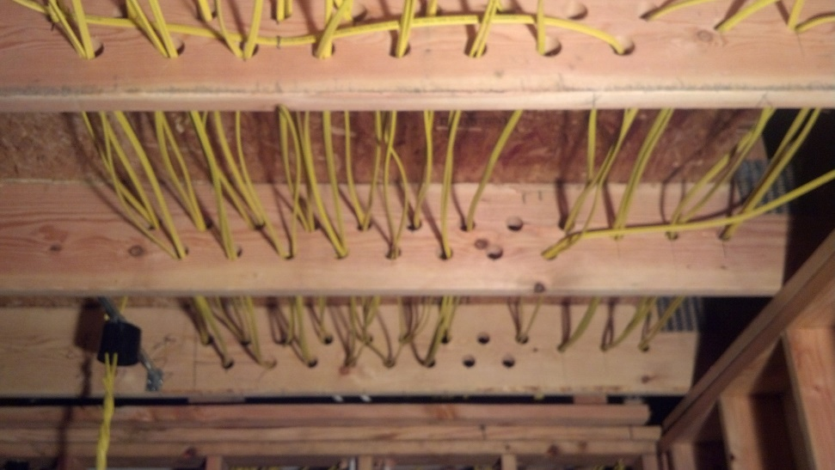
Reasons for Repairs – Jobsite Modifications
Holes may compromise the strength of the lumber, even if each individual hole is small.

Slide 23
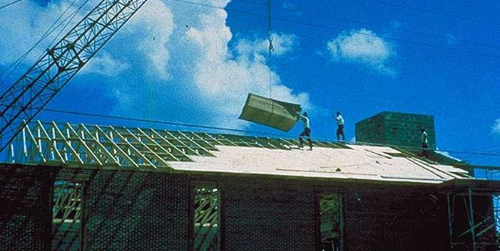
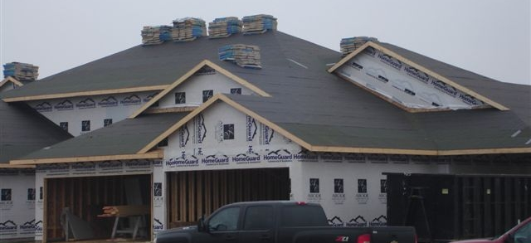
Reasons for Repairs – Overloading
Construction materials are often loaded onto roofs, which can cause damage
Loading materials at the ridge is particularly problematic

Slide 24
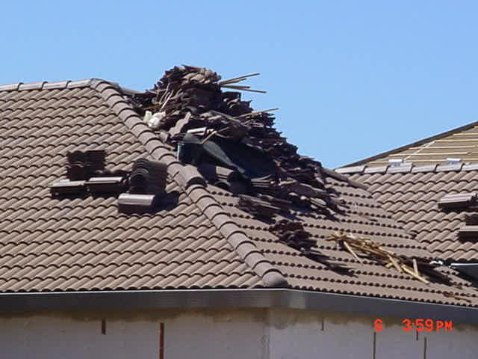
Reasons for Repairs – Overloading
Even smaller pieces of scrap material can be significant in large quantities

Slide 25
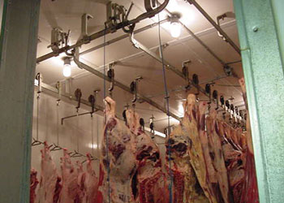
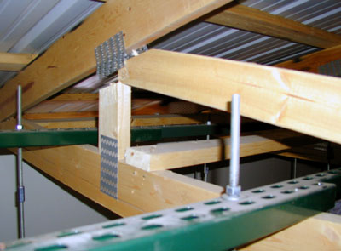
Reasons for Repairs – Overloading
A repair should be made if loads are added for which the truss was not designed.
This building was not originally designed as a butcher shop and the trusses were not designed for the loads required

Slide 26
Repairing Damaged Trusses – IBC/IRC
IBC 2303.4.5 / IRC R502.11.3 & R802.10.4
Alterations to trusses.
  Truss members and components shall not be cut, notched, drilled, spliced or otherwise altered in any way without written concurrence and approval of a registered design professional. Alterations resulting in the addition of loads to any member (e.g., HVAC equipment, piping, additional roofing or insulation, etc.) shall not be permitted without verification that the truss is capable of supporting such additional loading.

Slide 27
Repairing Damaged Trusses – ANSI/TPI 1
ANSI/TPI 1 2.3.4 – Requirements of the Contractor
Pre- and Post-Installation Check
  The contractor shall examine the trusses delivered to the jobsite and examine the trusses after they are erected and installed for:
  Dislodged or missing connectors,
  Cracked, dislodged or broken members, and
  Any other damage that may impair the structural integrity of the truss.

Slide 28
Repairing Damaged Trusses – ANSI/TPI 1
ANSI/TPI 1 2.3.4 – Requirements of the Contractor
Truss Damage Discovery
  In the event that damage to a truss is discovered that would likely impair the structural integrity of the truss , the contractor shall:
  Ensure the truss is not erected, or
  If the truss has already been erected, properly shore and support the truss to prevent further damage from occurring and keep the truss free of any load until field repairs have been properly completed.

Slide 29
Repairing Damaged Trusses – ANSI/TPI 1
ANSI/TPI 1 2.3.4 – Requirements of the Contractor
Truss Damage Responsibility
  In the event of damage the contractor shall:
  Contact the truss manufacturer and building designer to determine an adequate repair, and
  Construct the repair in accordance with the written instructions and details provided by the truss manufacturer, building designer and/or any registered design professional.

Slide 30
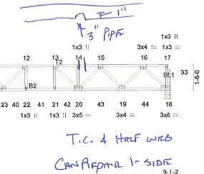
Repairing Damaged Trusses – BCSI
BCSI-B5 recommends the following steps to correct damage, jobsite modifications or installation errors:
  Temporarily brace or support the truss to prevent further damage to the truss and danger to the workers.
  Report damage, alterations or installation errors to the truss manufacturer immediately. Provide the following information, if possible:
    Job name and/or number
    Truss ID mark
    Location of the truss on the Truss Placement Diagram, as applicable
    Is the truss already installed?
    Type of damage (i.e., lumber and/or connector plates)
      If lumber (location of damage, dimension of damage, description of damage)
      If connector plates (Location of damage, joint number(s), size of plates, description of damage)
    If possible it is best to “mark-up” the TDD of the truss(es) that are damaged.
    Photographs are also helpful.

Slide 31
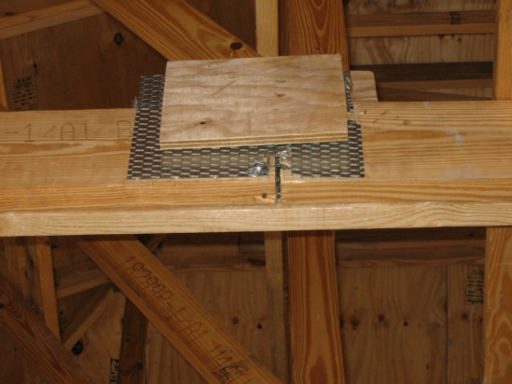

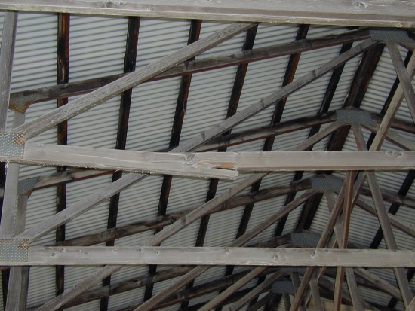
Repairing Damaged Trusses – BCSI
DO NOT repair without a Truss Repair Design Drawing (TRDD)
  Repairing a truss prior to receiving a TRDD could result in additional cost or an unrepairable condition.
  DO NOT install a broken or damaged truss until a repair has been made.

Slide 32
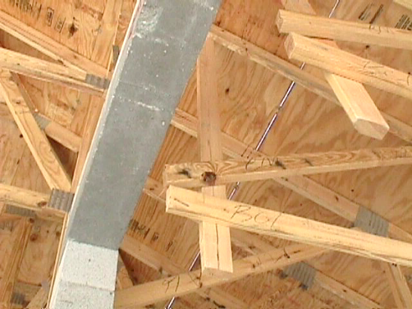

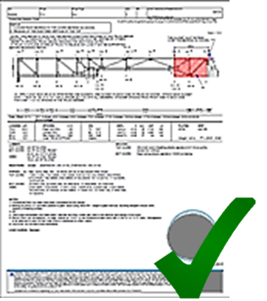
Repairing Damaged Trusses – BCSI
Prior to beginning the repair, lay the truss flat on a solid, level surface.
  If the truss is already installed, shore up the truss to relieve any load.
Repair the truss by following the information provided in the TRDD exactly. Make sure to use the correct materials as specified.
  Seek professional guidance if anything is unclear.
  Lumber and fasteners are not created equal
  Slight variations in loading or damage conditions can significantly affect the repair required.

Slide 33
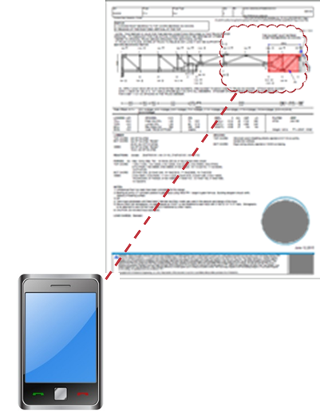
Repairing Damaged Trusses – BCSI
Keep the TRDD in case the building official, building designer or owner requests it.
If the TRDD is not for the specific condition you are repairing, do not use it. Always follow the TRDD prepared for the specific situation.
If the TRDD cannot be accomplished, inform the repair designer.

Slide 34
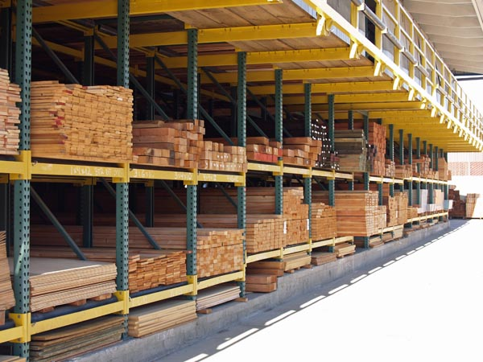
Common Repair Materials
Notify the truss designer or truss manufacturer about:
  Preferred materials or methods for the repair
  Availability of special order materials
  If there is a plate press on site
  Additional considerations not listed

Slide 35
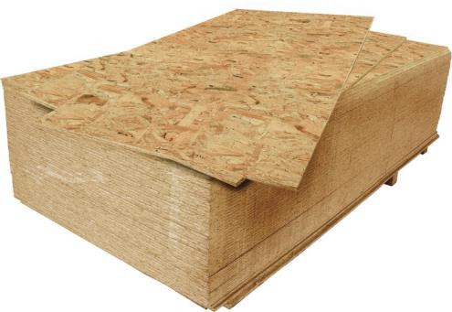
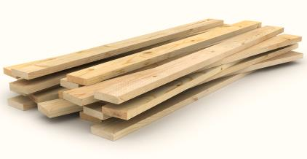
Common Repair Materials
OSB/Plywood
Lumber
Typically sold as 4’x8’ panels
Many thicknesses and span ratings
Ensure that the panels specified on the truss repair design drawing are used in the repair.
Many species and grades available
Typically, 2x nominal width is used for repairs
Commonly sold in nominal depths of 3, 4, 6, 8, 10, and 12 inches and in lengths up to 20 feet

Slide 36
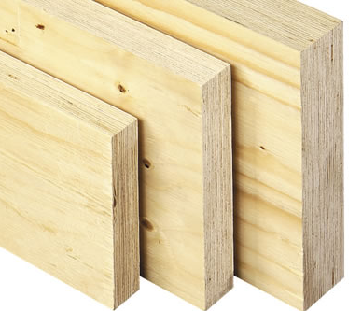
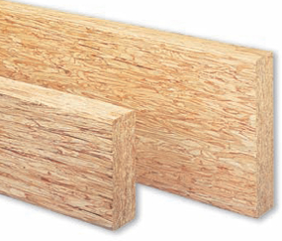
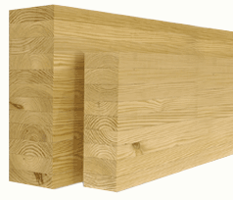
Common Repair Materials
Structural Composite Lumber
Available in many sizes and strengths, can be custom ordered
Available in lengths longer than 20 feet
Often used in longer span floor truss repairs when a repair is not possible with lumber or OSB
Laminated Veneer Lumber (LVL)
Parallel Strand Lumber (PSL)
Glued Laminated Timber (Glulam)

Slide 37
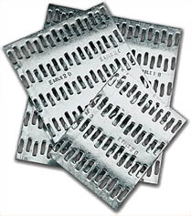
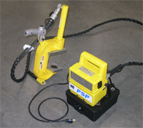
Common Repair Materials
Portable Plate Press
If available, a plate press may be used to replace a plate that is damaged or missing.
Note that the tooth holding value in lumber that has had a gusset plate removed is reduced by 50%.
Thus, the replacement plate must be sized larger than the original to allow the plate to connect into good lumber.
The new plate may not need to be 50% bigger, but the truss designer needs to recalculate the design to ensure the plate is adequate.

Slide 38
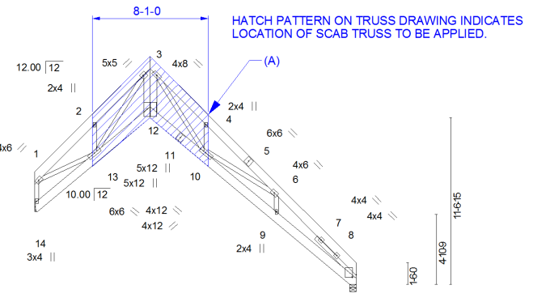
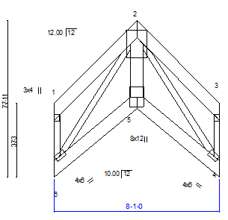
Common Repair Materials
Manufactured scab truss
Often used in situations where connection forces are high and the truss profile does not allow for a repair with typical materials.
Designed and built at a shop and installed on site.

Slide 39
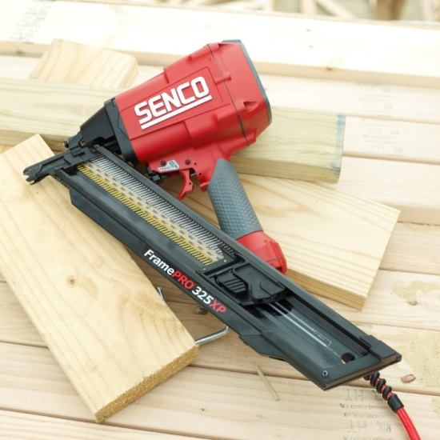


Common Repair Materials
Nails
Available in many lengths
Easily attached with a nail gun
Versatile and commonly found on the job site
Nails are less efficient in connecting wood members than metal gusset plates, but clinching, if allowed, can reduce the size of the repair

Slide 40






Common Repair Materials
Nails – Clinching
NDS 11.1.6.5 allows nails to be clinched in a gusset repair.
Clinching increases the withdrawal value of the nail by doubling the shear value of the nail.
This allows more force to be transferred directly to the adjoining members.
A gusset repair can be significantly smaller with clinched nails than non-clinched nails.

Slide 41

Common Repair Materials
Nails – Clinching
Gussets must be installed on both sides of the repair.
Fasteners must be of sufficient length to pass through both gussets and the main truss member while retaining a minimum of 3/8“ to be clinched.
Repairs that specify clinched nails must use clinched nails or the repair is not valid.
Verify in the field that nails are clinched where specified on the repair detail.

Slide 42


Common Repair Materials
Screws
Bolts
Available in many sizes and lengths
Screws have a higher withdrawal and lateral resistance values than nails and therefore a repair can use fewer screws than nails.
Spacing requirements may be higher than for nails
Consult manufacturer for design values and minimum spacing requirements.
Machine bolts such as ASTM A307 are typically specified
Can be used when large forces or multiple plies are involved
Not as commonly used in truss repairs

Slide 43

Common Repair Materials
Adhesives
Some adhesives create an excellent bond with the wood, providing greater strength than the wood itself.
Application conditions must be considered including:
  Temperature
  Moisture
  Surface condition of the wood member
  Quality and supervision of labor
  Cure time

Slide 44
Conclusion
Follow the guidelines in this presentation to ensure that the repair is completed in the safest and most economical way.
When a damage condition is discovered, notify the truss manufacturer immediately and provide complete information and photos of the damage condition.
Follow the instructions in the repair detail completely to prevent additional damage or rework.
Keep the repair detail and provide to the building inspector if requested.

Slide 45
Resources
ANSI/AWC NDS-2012, ASD/LRFD NDS; National Design Specification for Wood Construction. 2012; American Wood Council, 222 Catoctin Circle, SE, Suite 201, Leesburg, VA 20175.
American National Standard: National Design Standard for Metal Plate Connected Wood Truss Construction, ANSI/TPI 1 – 2014; Truss Plate Institute; Revision of ANSI/TPI 1 – 2007.
BCSI Building Component Safety Information: Guide to Good Practice for Handling, Installing, Restraining & Bracing of Metal Plate Connected Wood Trusses 2013 Edition, Chapter BCSI-B5: Truss Damage, Jobsite Modifications & Installation Errors; Jointly Produced by the Structural Building Components Association and Truss Plate Institute; Updated March 2015.

Slide 46


Resources
Wood Materials
Fasteners & Connector Plates
NDS
AITC
APA-EWS
TECO
SCL Manufacturer
SBCA
TPI
Technical Evaluation Reports
NDS
Manufacturers
AISC
Technical Evaluation Reports
TPI

