Slide 1
Code Compliant Construction of Conventionally Framed Roofs and Roof Trusses
Overview

Slide 2
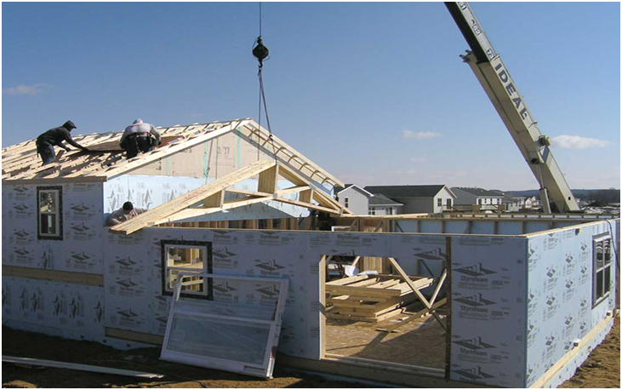
Introduction
This presentation covers the requirements for conventionally framed roofs and roof truss construction per International Residential Code (IRC) Section 802.

Slide 3
Background
The code allows portions of a structure to be engineered in accordance with the International Building Code (IBC), without the entire structure requiring engineering. (R301.1.3)
This means that some portions of the building may be engineered (e.g. trusses and other components), but the structure may still be able to utilize IRC prescriptive requirements.

Slide 4
Applications
Structures within the scope of prescriptive code compliance include:
  Detached one- and two-family dwellings and townhouses with separate means of egress [R101.2]
  Light-frame construction (platform or balloon frame) [R301.1.2]

Slide 5
Prescriptive Code Compliance
The following three tables list additional criteria the structure must meet with respect to loads and geometry:

Slide 6
Prescriptive Code Compliance - Loads
Load | Maximum Allowed | Code Section
Roof Live | 20 psf | R301.6/Table R301.6
Ceiling/Floor Live | 10, 20, 30 or 40 psf | R301.5/Table R301.5
Snow | 70 psf | R301.2.3
Wind Speed (2012) | 110 mph | R301.2.1.1/Figure R301.2(4)A
Wind Speed (2006/9) | 110 mph 100 mph hurricane-prone regions | R301.2.1.1
Seismic – Townhouses | SDC: C, D₀, D₁, & D₂ | R301.2.2 (SDC: A & B exempt)
Seismic – 1- & 2-family | SDC: D₀, D₁, & D₂ | R301.2.2 (SDC: A, B & C exempt)

Slide 7
Prescriptive Code Compliance - Structure Geometry
Description | Maximum Allowed | Code Section
Story Height | 10' (laterally unsupported) plus floor framing not to exceed 16" or 12' as allowed by exception | R302.3/Table R602.3(5)
Number of Stories | 3 above grade plane | R101.2
Building Width (perpendicular to ridge) | 36' | footnote to Tables R502.5(1) & R802.5(2)]
Building Length (parallel to ridge) | Not specified for wood | [CFS & ICF limited to 60']
Mean Roof Height | Up to 60' with application of adjustment factors | Table R602.3(1), Table R602.10.3(1) & Section R802.11.

Slide 8
Prescriptive Code Compliance - Roof Geometry
Description | Maximum Allowed | Code Section
Building Width (perpendicular to ridge) | 40' (36' building plus max 24" overhang each side) | footnote to Tables R502.5(1) & R802.5(2) & R802.7.1.1
Rafter Span | Maximum tabulated or 26' | Footnote b Table R802.5(1)-(8)
Ceiling Joist Span | Maximum tabulated or 26' | Footnote b Table R802.4(1) & (2)
Rafter/Ceiling Joist Spacing | 24" o.c. | Table R802.5(1)-(8) & Table R802.4(1) & (2)
Roof Pitch | 3/12 to 12/12 or greater | Table R301.6 & R802.3

Slide 9
Prescriptive Code Compliance
Finally, and perhaps most importantly, to meet prescriptive code compliance:
  Construction documents shall be of sufficient clarity to indicate the location, nature and extent of work and show in detail that such work conforms to the provisions of the code [R106.1.1].
  A complete load path from peak of roof to the foundation is required [R301.1].

Slide 10
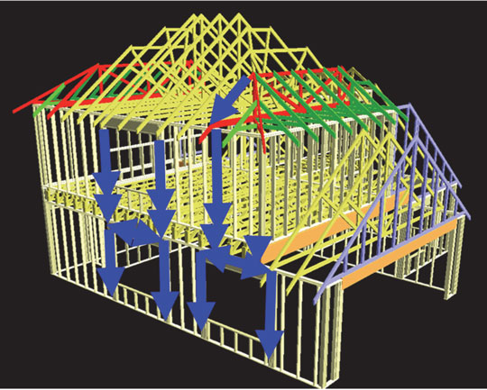
What is a Load Path?
“A complete load path…meets all requirements for transfer of all loads from their point of origin through the load-resisting elements to the foundation.” (R301.1)

Slide 11
What is a Load Path?
While framers build from the bottom up, load paths must be traced from the top down.
Loads are typically applied on the roof surface and travel down to the foundation.
In between roof and foundation, loads must be transferred along elements that are adequate to carry these loads.

Slide 12
What is a Load Path?
Vertical
Loads
(gravity and
uplift)
Lateral
Loads
(parallel
to wall)
Loads and load directions
  Vertical loads
    Gravity – easiest to trace from roof to foundation
    Uplift – less well understood
  Lateral loads
    Parallel and perpendicular to structural element
    e.g. Wind, Seismic – most difficult to address adequately
Lateral
Loads
(perpendicular
to wall)
Lateral Load
applied to end wall
Lateral Load
applied to side wall

Slide 13
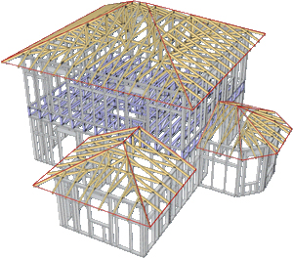
Conventional Framing Problem Areas
Conventional roof framing and compliance with code requirements, including those involving the load path, is a complex topic.

Slide 14
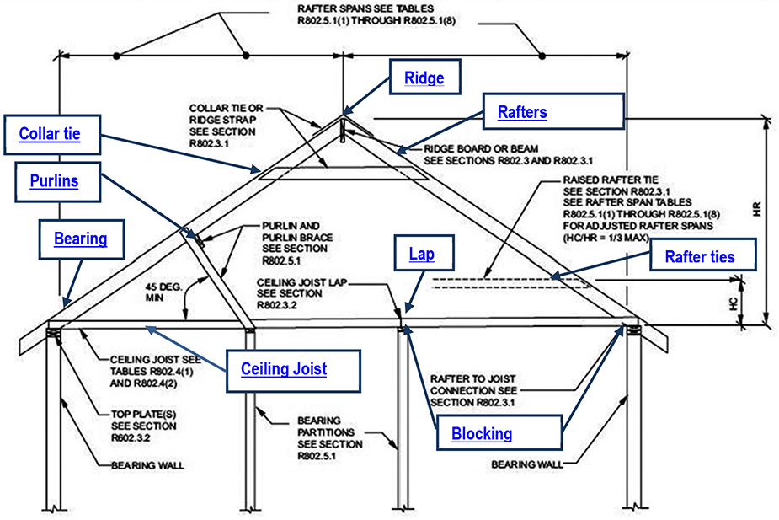
Conventional Framing Requirements
The IRC covers many roof framing elements in the prescriptive requirements:
  Gable/Shed
  Hip/Valley
  Roof Openings
  Notches and Holes

Slide 15
Conventional Framing Requirements
However, the IRC gives no guidance on other aspects of the roof framing, such as:
  Bracing design for high end of hip/valley rafters
  Bracing design for rafter purlins
  Non-symmetrical hip roofs
  Roof diaphragms with plate height changes
  Large roof openings (greater than 6' wide)

Slide 16
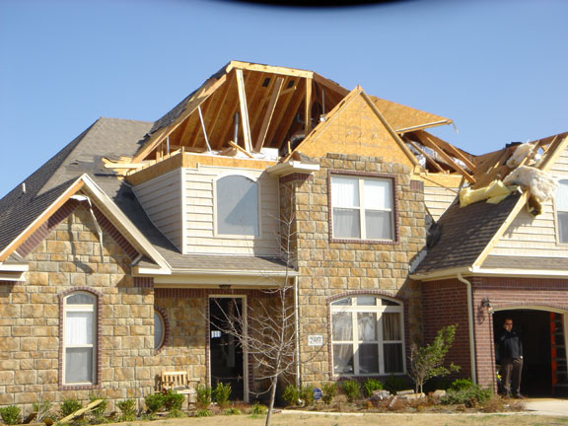
Conventional Framing Problem Areas
A clear understanding of all framing code requirements is essential to avoid many pitfalls, as shown in the following examples.
Source: Aries Engineering

Slide 17
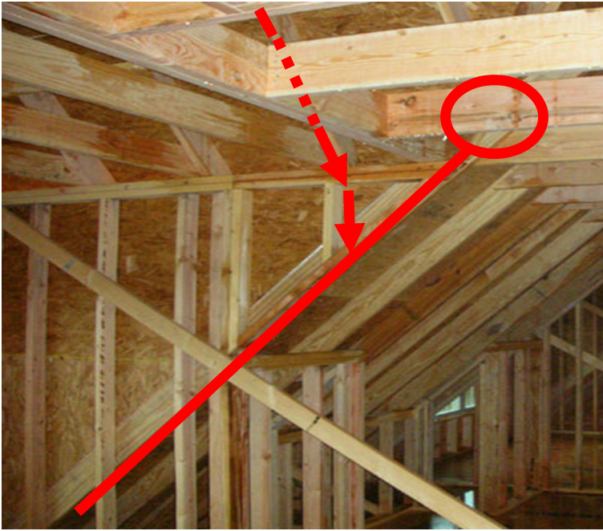
Example: Load Path (Roof Dormer)
The main ceiling joists are supported by a girder that is supported on next to nothing.
  The joists should run further into the dormer, and the girder supporting them should be supported by posts in the dormer side walls.

Slide 18
Example: Load Path (Roof Dormer)
The load path from the dormer flows down the side wall. However, the side wall does not extend to the floor in this area.
  The load path needs to flow into the rafter next to the dormer side wall.
However, only a single rafter is placed here.
  If this rafter is supporting the dormer roof, it should designed to carry the dormer.

Slide 19
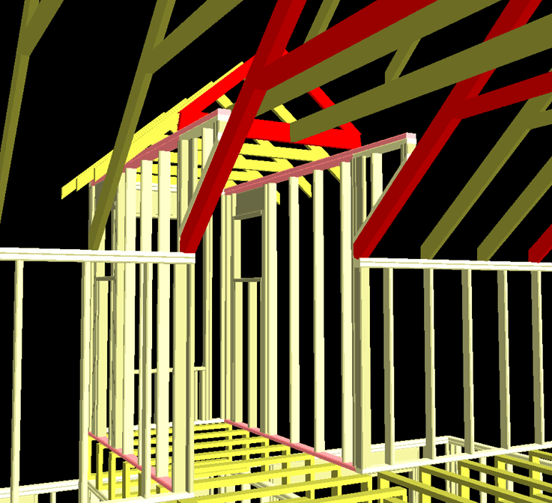
Example: Load Path (Roof Dormer)
If this had been designed with trusses, a tail bearing girder truss designed to carry this load would have been used here.

Slide 20
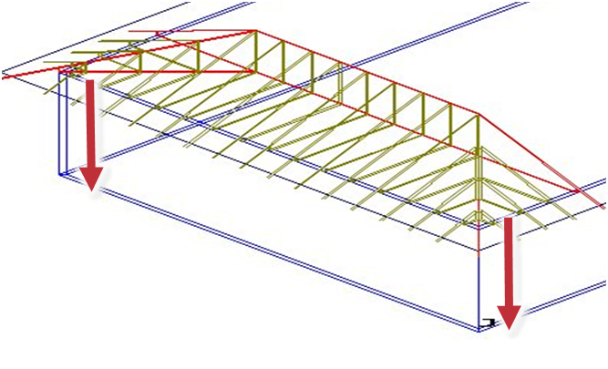
Example: Load Path (Wall)
Whether using conventional framing or trusses, it is essential to pay attention to load paths, especially with today’s larger, more complex houses.

Slide 21
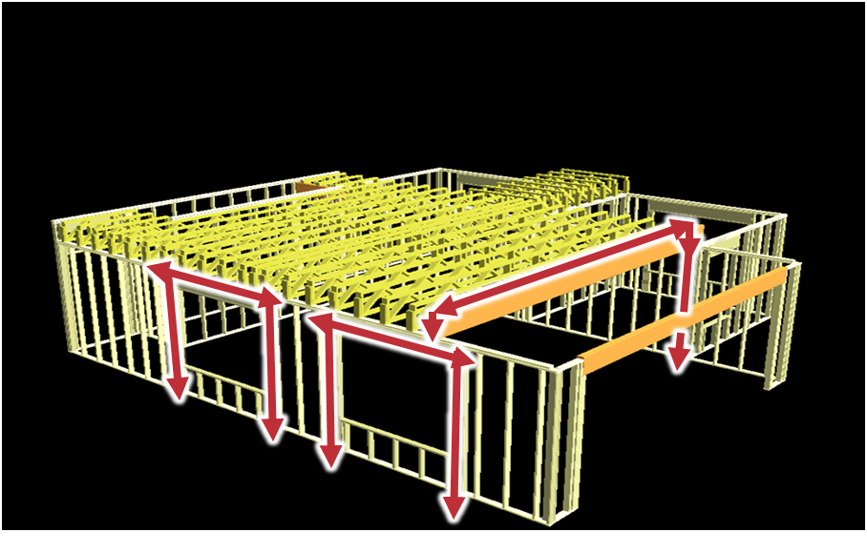
Example: Load Path (Wall)
Where girder trusses are needed, large concentrated loads on exterior walls can occur.

Slide 22
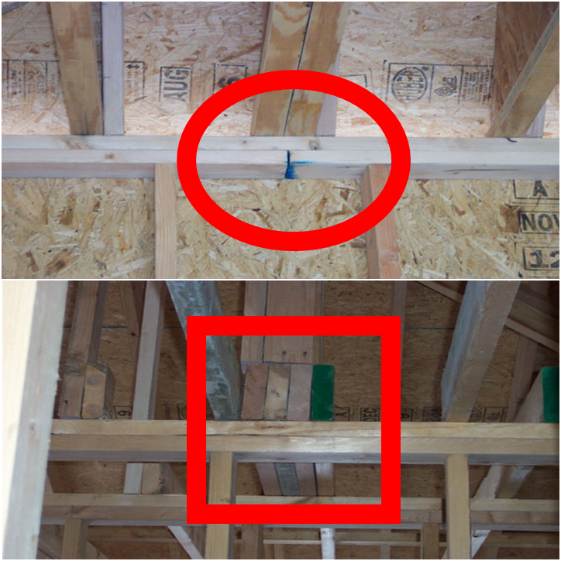
Example: Load Path (Wall)
Doubled I-joists in a roof-ceiling assembly carry a significant load, but they bear on two top plates between studs.
  Note the joint in the lower of the two top plates. Joints in plates need not occur over studs; however, this is a particularly bad place for one.
Similarly, a 4-ply beam bearing on the wall at right has no studs under it to transfer the load to the floor below.

Slide 23
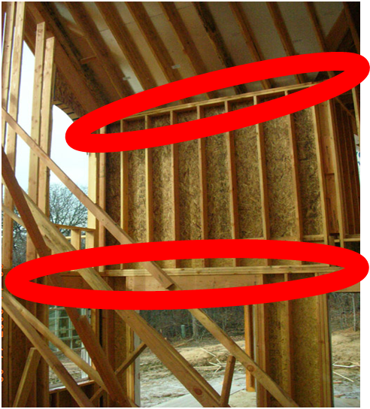
Example: Load Path (Wall)
For tall walls (over 10’ in height) both gravity and lateral load paths need to be considered and are more complicated and critical.
Any break in the continuity of these studs creates a “hinge” in the wall, which can easily deform or fail under wind load conditions.

Slide 24
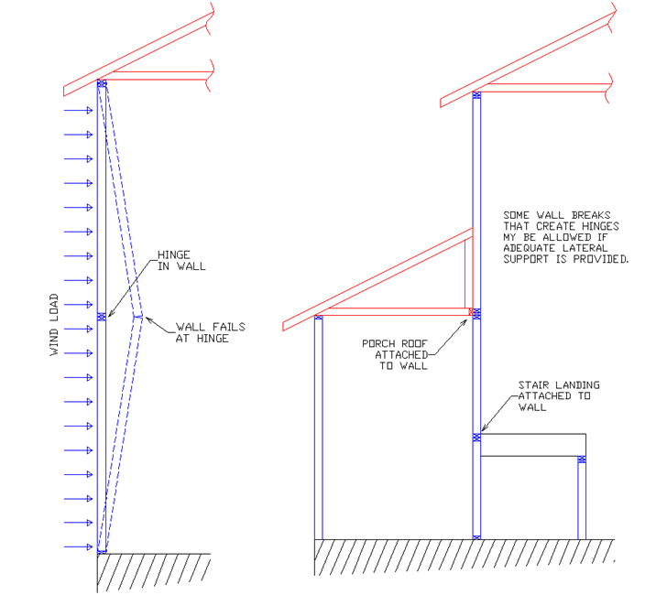
Example: Load Path (Wall)
Not only is there a hinge created in this case but the outward thrust of the rafters also needs to be resisted.
It is not clear in the previous picture how this is being accomplished.

Slide 25
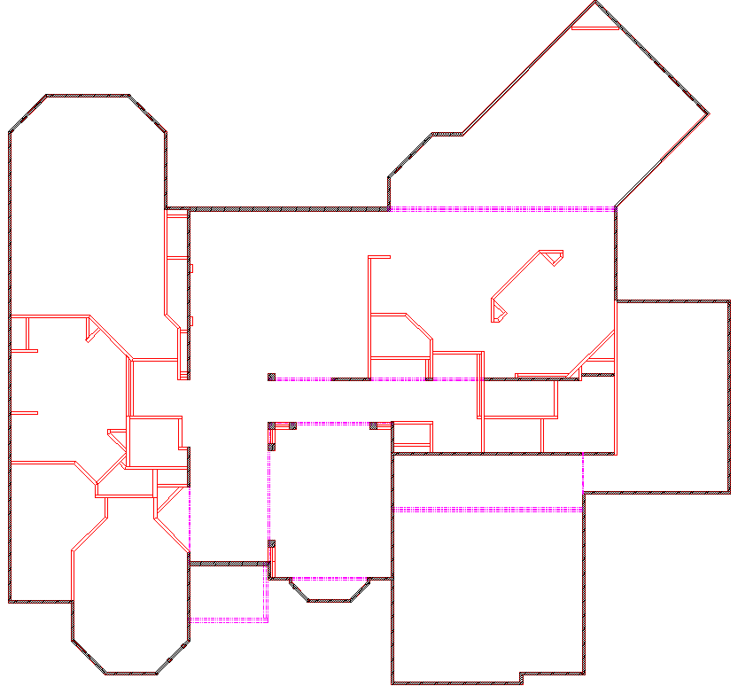
Example: Load Path (Floor)
In truss construction, loads are typically carried by the outside walls and transferred down to the foundation walls.
With conventional frame construction, loads must be transferred through the interior of the structure.

Slide 26
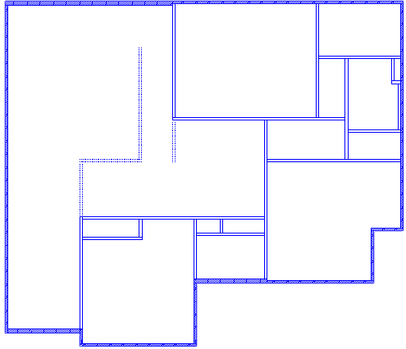
Example: Load Path (Floor)
This can lead to large concentrated loads transferred through interior walls.
Loads cannot be terminated on or, even worse, between floor framing elements without specific engineering considerations.

Slide 27
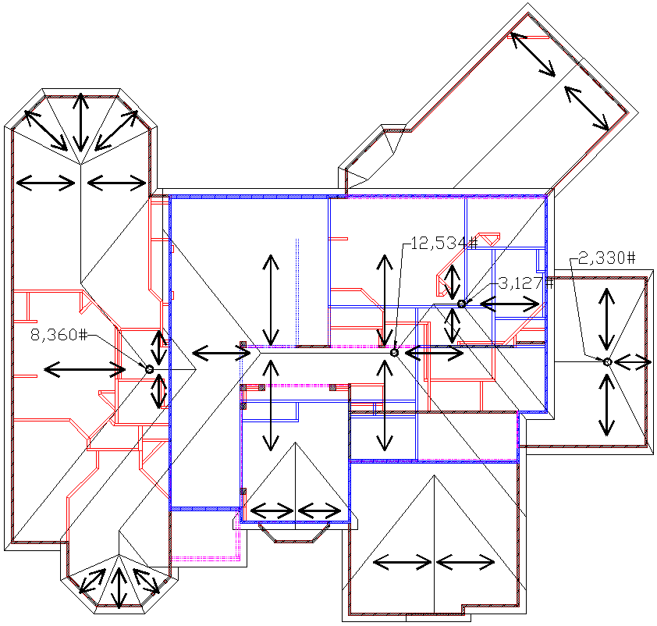
Example: Load Path (Floor)
In this house plan, very few framing elements stack from level to level.
The loads shown are approximate and reflect a 20 psf live or snow load and a 10 psf dead load.
Loads will vary depending on snow load and details of the framing.

Slide 28
Example: Load Path (Floor)
With few walls stacking or crossing, very few points exist to take roof loads down to the foundation.
The stack points that do exist are not in useful locations.

Slide 29
Conventional Framing Problem Areas
Additional areas to watch closely:
  Connections
  Supports
  Structural member sizing

Slide 30
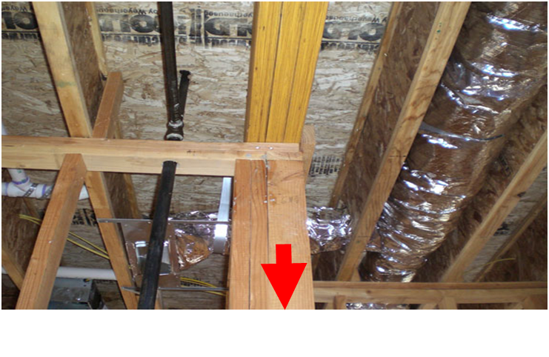
Example: Connection (Floor Sag)
In this example, you can see a post at a corner of an interior wall. It is carrying a significant load from the beam above.

Slide 31
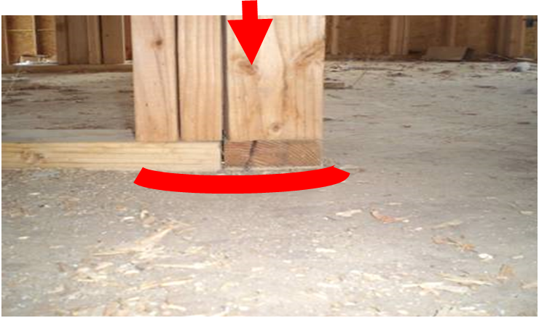
Example: Connection (Floor Sag)
In the photo on the right, you can see this post rests on two different bottom plates and the floor appears to be sagging.
This is a case where the roof loads applied to the floors were not considered – thus the sag.

Slide 32
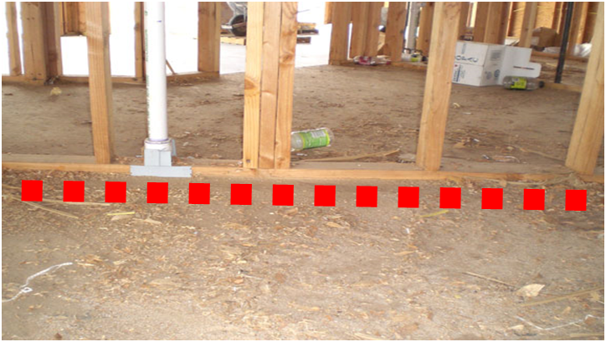
Example: Connection (Floor Sag)
In this photo, we can see a fairly clear sag in the floor at this post in a wall.
This demonstrates that, if the path for these loads is not considered all the way down to a foundation element, there can easily be deflection problems, or low points in floors and possibly failure.
Again, in this case the roof loads applied to the floors were not considered – thus the sag.

Slide 33
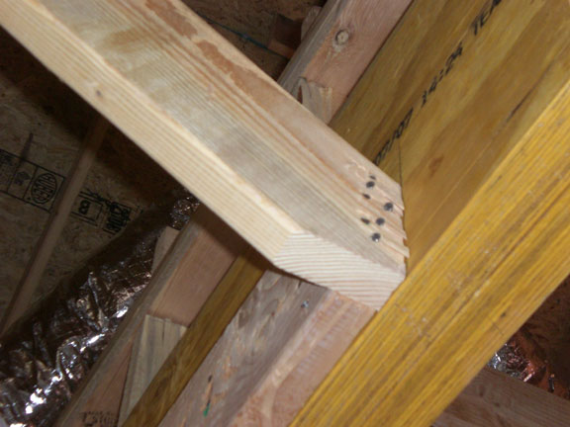
Example: Connection (Power Blocking)
The IRC includes fastener requirements for conventional construction within the scope of the code.
Problems may arise where there is end-grain nailing or where multiple members are joined.
For example, nailing details like the one at right may or may not be sufficient, depending on conditions.

Slide 34
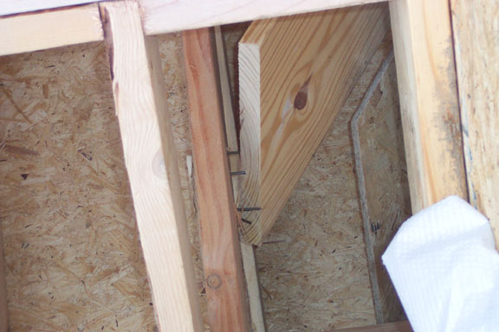
Example: Connection (Power Blocking)
“Power Blocking” is not addressed or approved by the building code.
In some cases, engineered design may be required.
With trusses, much shorter end jacks are made to have a mechanical connection.
Even where the code does cover a specific situation, it is often difficult to inspect whether the fasteners used meet code.

Slide 35
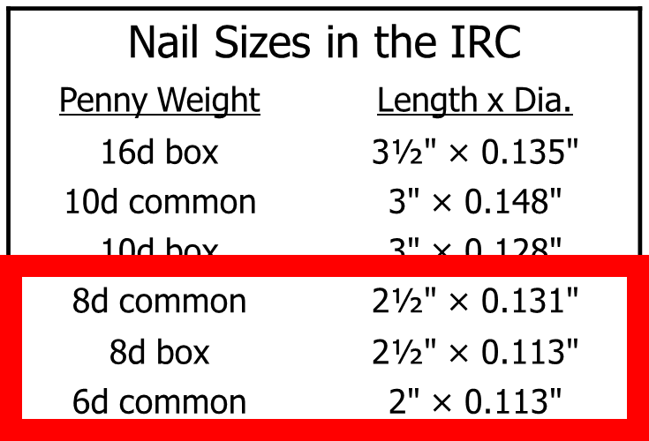
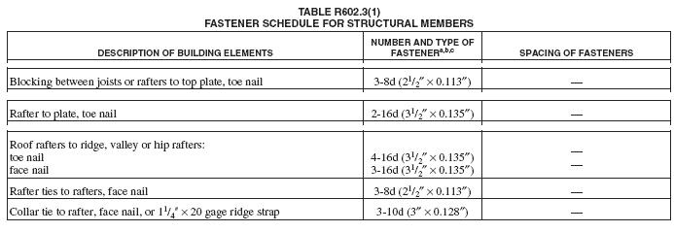
Example: Connection (Roofs)
A basic problem of inspecting nailed connections is knowing whether the nails meet the code’s fastener schedules.
IRC Table R602.3(1) addresses a number of roof framing items

Slide 36
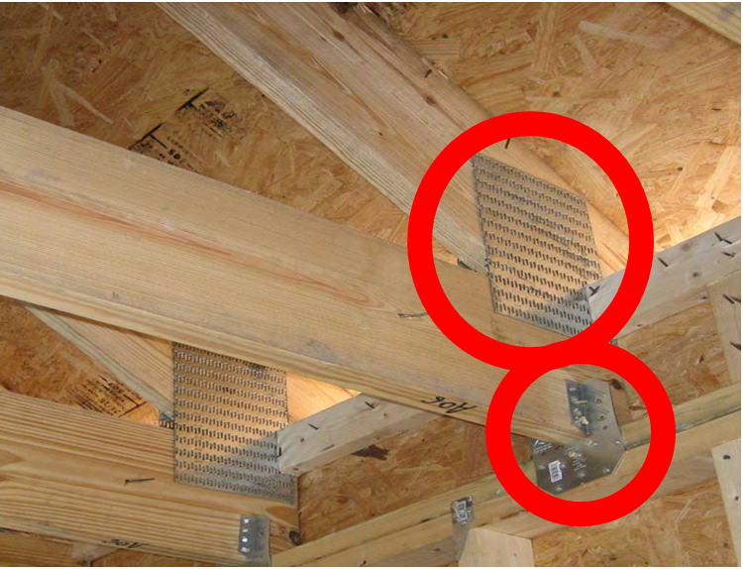
Example: Connection (Roof Diaphragm)
The heel connection at right was made in the plant, avoiding the difficulty of correctly connecting rafters to joists as in conventional construction.
With trusses, the overall flow of loads is well defined, so specific mechanical fasteners can be utilized to meet resistance needs.

Slide 37
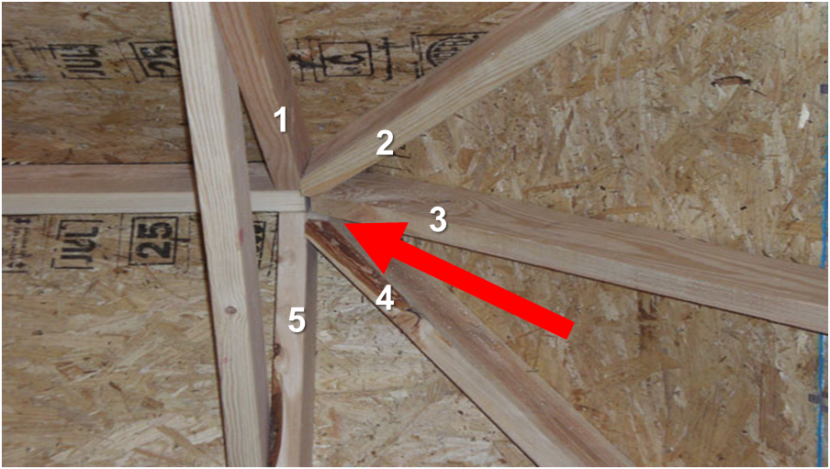
Example: Connection (Hip Rafters)
This connection is probably not adequate.
Trying to attach 5 members to the end of the ridge would require so many nails it would cause splitting in the ridge.
End and edge distance limits on proper nailing would be violated.
This joint as built is also weakened by the gap between these two members.

Slide 38
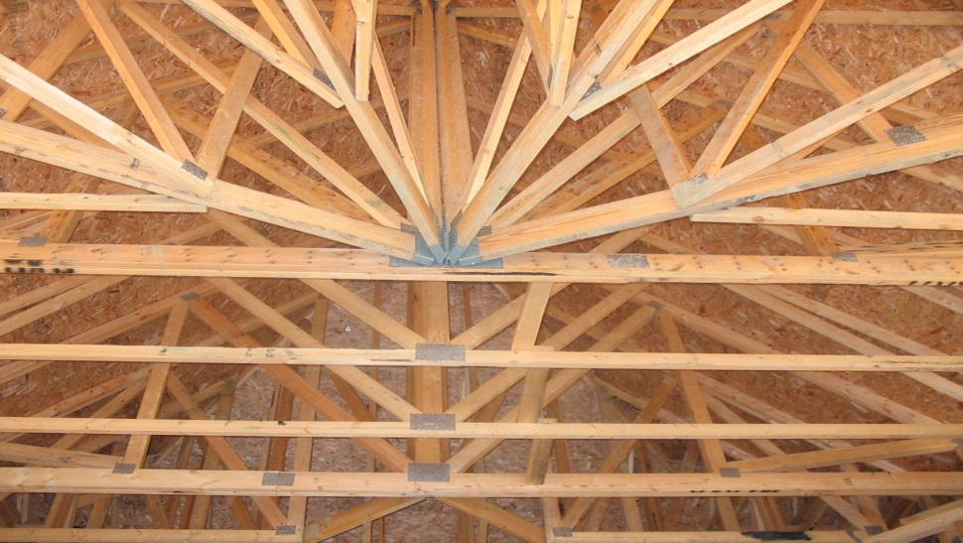
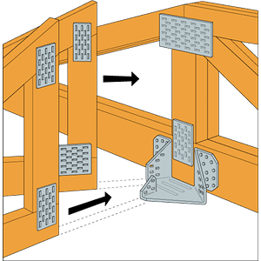
Example: Connection (Hip Rafters)
With structural building components, connections where multiple members are joined are typically made with engineered mechanical fasteners.

Slide 39
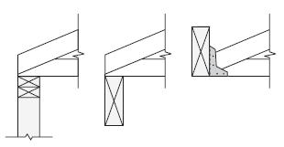
Example: Support (Bearing)
Inadequate bearing supports are another problem in conventional construction.
A structural bearing element must carry a structural member’s gravity or uplift loads to the foundation.
The bearing element must also be able to carry any concentrated or lateral loads parallel or perpendicular to the bearing member.

Slide 40
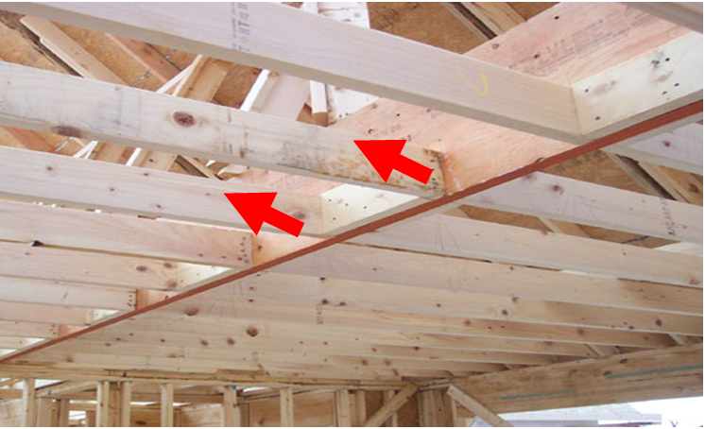
Example: Support (Bearing)
Braces often connect to the top edge of LVL or conventional lumber beams.
Beam span tables are typically not accurate when braces are used because the tables assume:
  Uniform loads only, while the braces apply concentrated loads to the beam
  Full top edge support is present (to prevent torsional buckling)
The top edge of the LVL at right is not braced.
In fact, the braces supporting the purlin run into the LVL at an angle, increasing buckling forces on it.

Slide 41
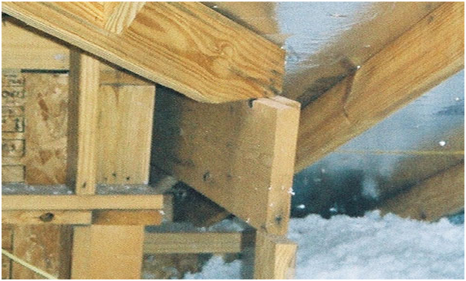
Example: Support (Rafter)
This is an example of inadequate support of a valley rafter bearing on an unsupported beam.

Slide 42
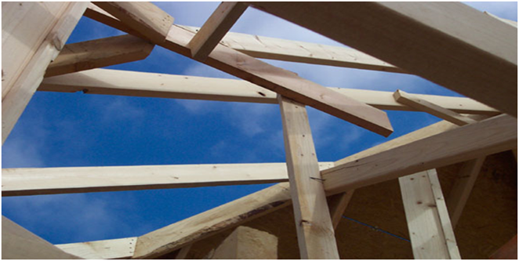
Example: Support (Rafter)
The photo on the right shows the end of a ridge beam for a dormer bearing on a 2x4.
These problems of structural support in conventionally framed roofs tend to appear more often in complex and large roofs.

Slide 43
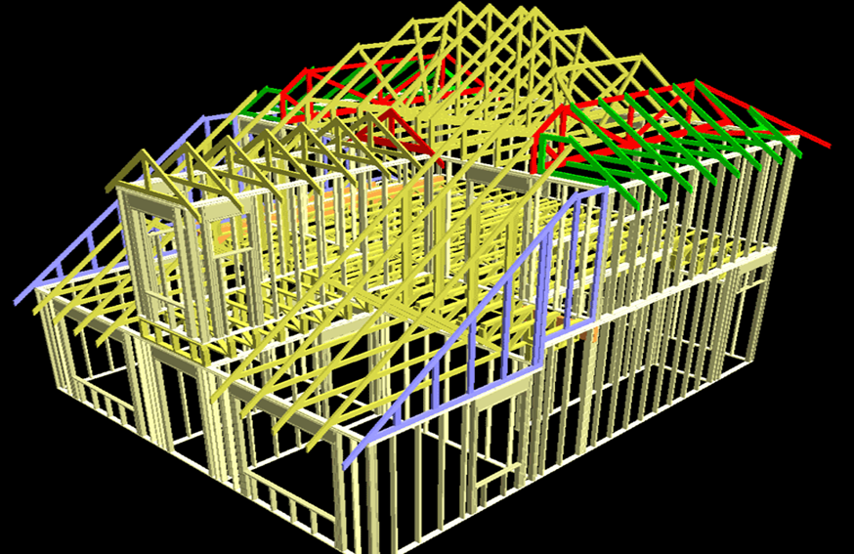
Example: Support (Rafter)
The design of roofs of almost any complexity or size, however, can be accommodated fairly simply with trusses.
The Truss Placement Diagram shows how these are laid out, and there is no guesswork on the jobsite about how the roof is to be adequately structurally supported.

Slide 44
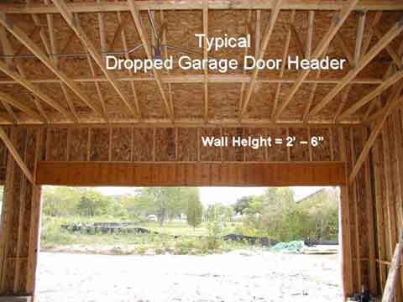
Example: Support (Header)
This is a field example of a very common “Unbraced Garage Door Header”.
The beam spans a 18’-3” rough opening with a 2’-6” cripple wall on top and 24’-0” roof trusses at a 6/12 roof pitch on top of the cripple wall.

Slide 45
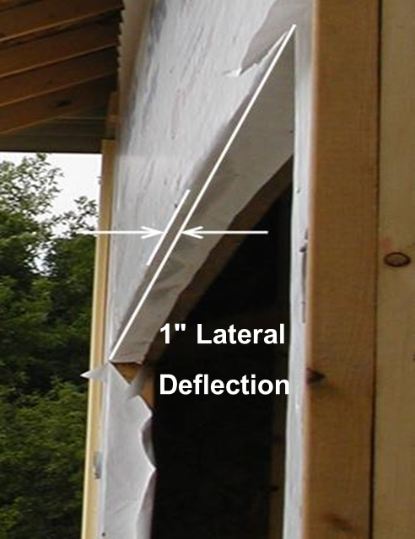
Example: Support (Header)
The beam has no lateral support at its top to prevent it from buckling laterally.
In situations like this, the beam should be located above the cripple wall to receive lateral support from the roof framing above.

Slide 46
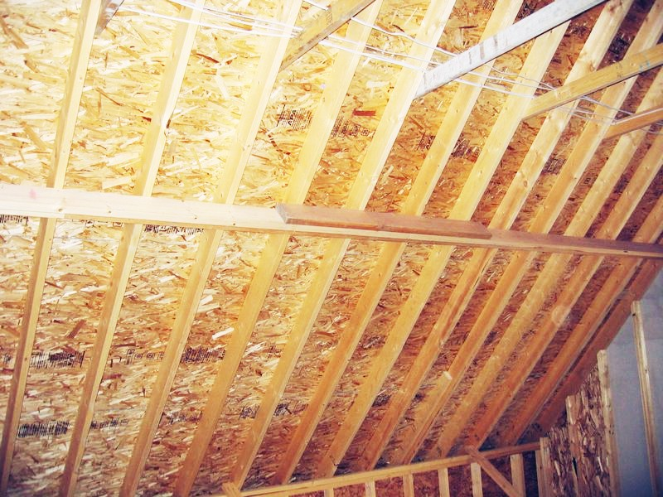
Structural Member Sizing Example
Another problem is the proper sizing of structural members.
The roof at right has 2x8 #2 SYP rafters spanning 15’ at 24” o.c.
Per the IRC, the maximum span for rafters of this material in this situation is typically 15’-10”.
However, there are no ceiling joists at the bottom of the attic space or other method of resisting the outward push of the rafters.

Slide 47
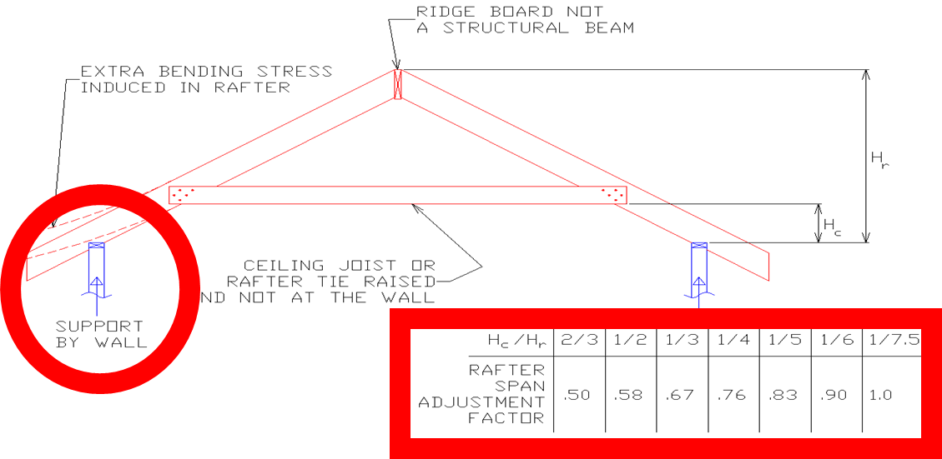
Structural Member Sizing Example
The tabulated rafter spans assume that ceiling joists are present at the bottom of the attic space.
Because of the extra bending force induced in the rafter, the maximum rafter spans must be reduced.
When ceiling joists or rafter ties are located higher in the attic space, the maximum rafter spans shall be multiplied by adjustment factors.

Slide 48
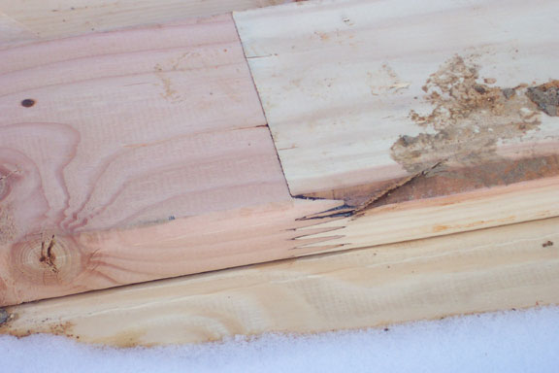
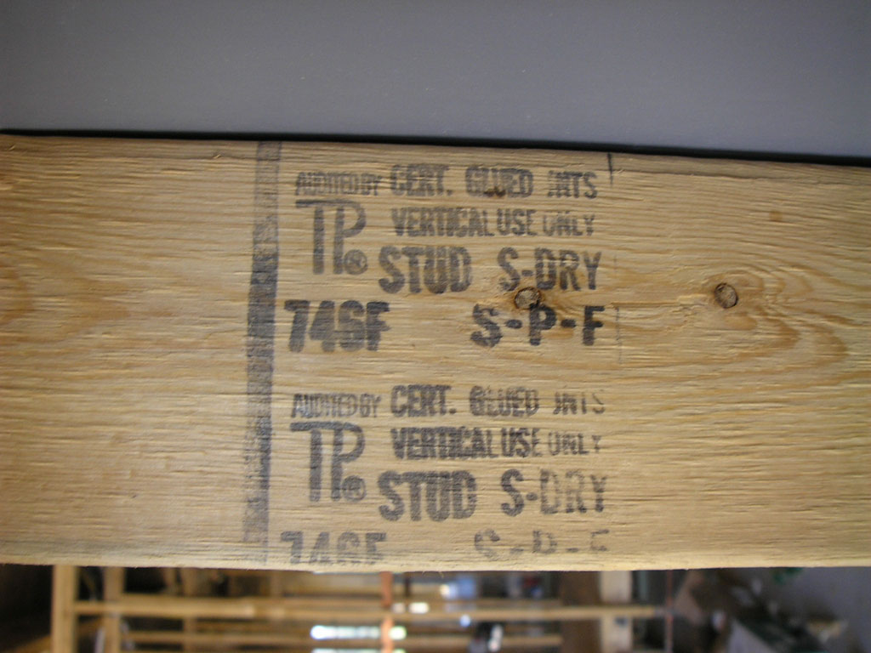
Roofs – Structural Member Sizing
Some finger-jointed lumber may be used in rafters and trusses.
If stamped “vertical use only”, the finger-jointed lumber should not be used in horizontal structural applications such as rafters or trusses.

Slide 49
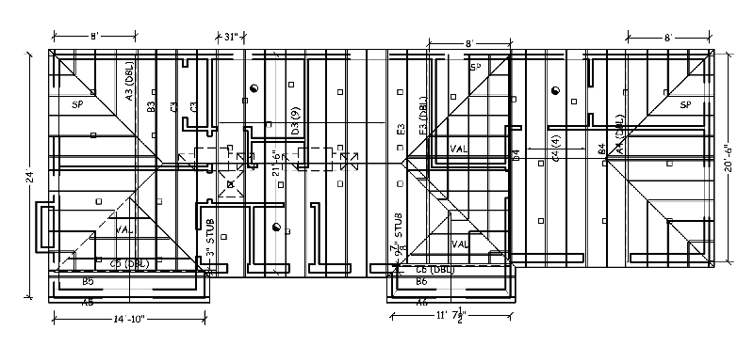
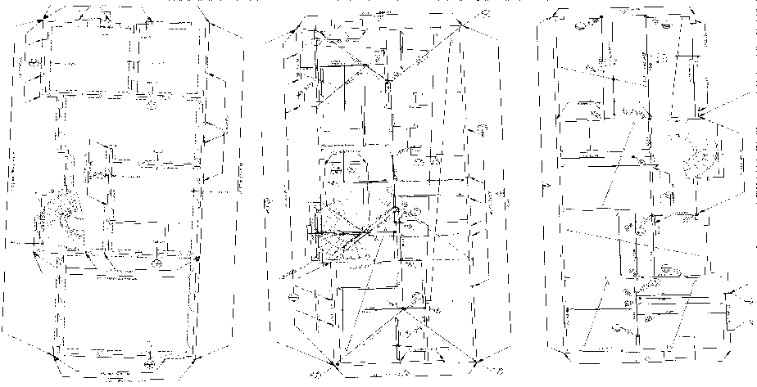
Framing Plan
A framing plan provides information needed by the inspector, and helps avoid many of the ad-hoc framing solutions we see in the field.
With truss construction, the Truss Placement Diagram serves this purpose.
Often, with stick-framed houses, a framing plan is not provided.

Slide 50
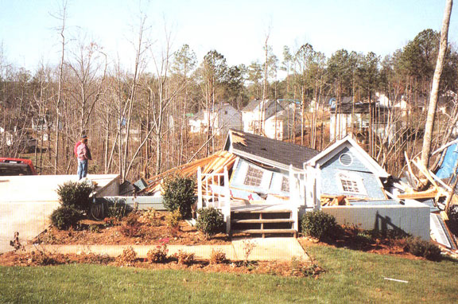
Findings
Inspection of conventional roof framing and all load paths in a structure can be a challenge.
  Local education can help everyone understand the code and provide for safer structural performance.
Source: Aries Engineering

Slide 51
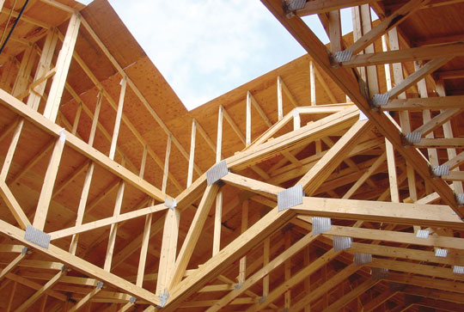
Findings
Engineered roof truss framing simplifies the creation of a continuous load path that is fully compliant with Section R301.

Slide 52
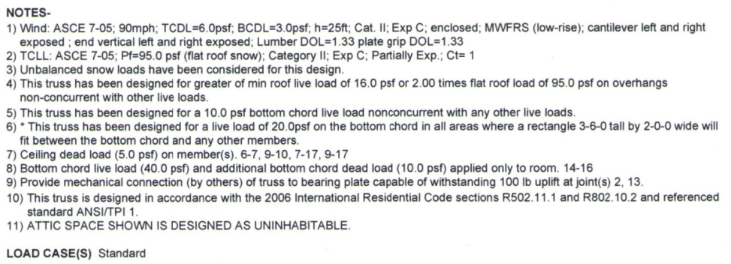
Findings
Truss Design Drawings (TDD) comply with Sections R802.10.3 and R802.11 where applied loads and load path resistance is explicitly defined on the TDD.

Slide 53

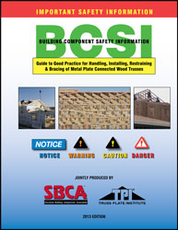

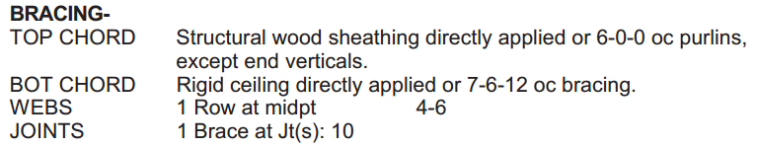
Findings
Bracing and related connections can be found on the TDD and in BCSI.
This supports a code compliant continuous load path
  Uplift and gravity loads flow from the roof, through the permanent restraint/bracing of the structure, to the foundation system

Slide 54
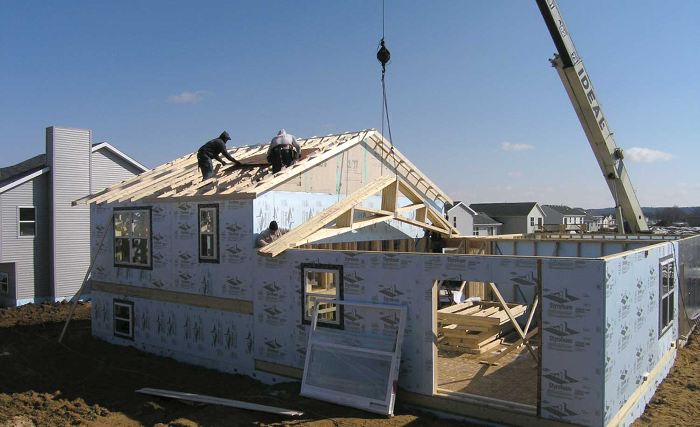
Solutions
Options to ensure code compliant framing:
  Hire engineer of record
  Eliminate ad-hoc framing solutions
  Use Structural Building Components!

Slide 55
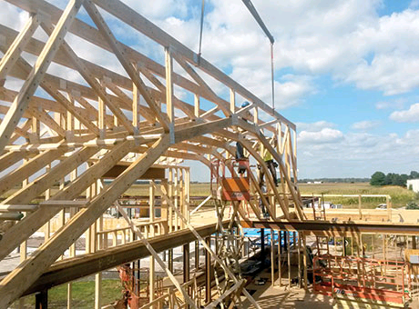
Solutions
Builder:
  Faster to install
  Easier to schedule
  Safer jobsite
  Speed and simplicity
Inspector:
  Less to inspect
  Engineer usually involved
Homeowner
  Fewer potential problems

Slide 56
Conclusion
Using trusses & building components can make IRC code compliance much easier and result in a more structurally accurate and higher quality building.

Slide 57
References
SRR 1410-02 Code Compliant Construction of Conventionally Framed Roofs and Roof Trusses
Building Component Safety Information (BCSI): Guide to Good Practice for Handling, Installing & Bracing of Metal Plate Connected Wood Trusses, Structural Building Components Association and Truss Plate Institute, 2013.
International Residential Code (IRC), International Code Council, 2012.
TPI 1 – National Design Standard for Metal Plate Connected Wood Truss Construction, Truss Plate Institute, 2007.
WCD 1 – Details for Conventional Wood Frame Construction, American Wood Council, 2001.
Wood Frame Construction Manual (WFCM), American Wood Council, 2012.

